Slide 1
Chapter 4
MIDTERM
THURSDAY, OCTOBER 17 IN LAB
Queues

Slide 2
Chapter Objectives
Learn how
to represent a waiting line (queue)
to use the methods in the Queue interface
for insertion (offer and add),
removal (remove and poll), and
for accessing the element at the front (peek and element)
to implement the Queue interface using a single-linked list, a circular array, and a double-linked list

Slide 3
Chapter Objectives
To become familiar with the Deque interface
Use its methods to insert and remove items from either end of a queue

Slide 4
Queue
The queue, like the stack, is a widely used data structure
A queue differs from a stack in one important way
A stack is LIFO list – Last-In, First-Out
while a queue is FIFO list, First-In, First-Out

Slide 5
Job Interview Questions
What is the difference between a queue and a stack?
Describe which one should be implemented with a singly linked list and which one should be implemented with doubly linked list.
How to implement a queue simply using two stacks.

Slide 6
Queue Abstract Data Type

Slide 7
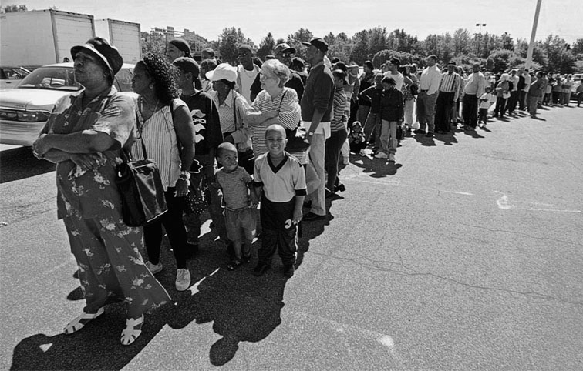
Queue Abstract Data Type
A queue can be visualized as a line of customers waiting for service
The next person to be served is the one who has waited the longest
New elements are placed at the end of the line

Slide 8
Print Queue
Operating systems use queues to
keep track of tasks waiting for a scarce resource
ensure that the tasks are carried out in the order they were generated
Print queue: printing is much slower than the process of selecting pages to print, so a queue is used

Slide 9
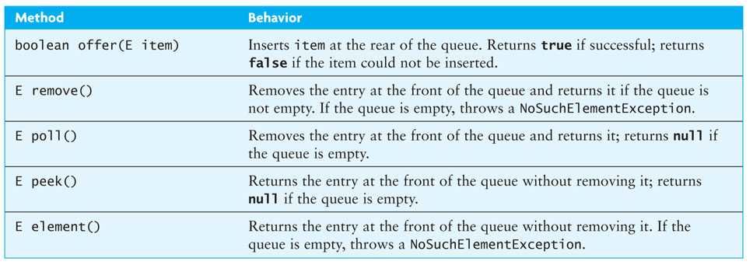
Specification for a Queue Interface
The Queue interface implements the Collection interface (and therefore the Iterable interface), so a full implementation of Queue must implement all required methods of Collection (and the Iterable interface)

Slide 10
Class LinkedList Implements the Queue Interface
The LinkedList class provides methods for inserting and removing elements at either end of a double-linked list, which means all Queue methods can be implemented easily
The Java 5.0 LinkedList class implements the Queue interface
Queue<String> names = new LinkedList<String>();
creates a new Queue reference, names, that stores references to String objects
The actual object referenced by names is of type LinkedList<String>, but because names is a type Queue<String> reference, you can apply only the Queue methods to it

Slide 11
Implementing the Queue Interface

Slide 12
Using a Double-Linked List to Implement the Queue Interface
Insertion and removal from either end of a double-linked list is O(1) so either end can be the front (or rear) of the queue
Java designers decided to make the head of the linked list the front of the queue and the tail the rear of the queue
Problem: If a LinkedList object is used as a queue, it will be possible to apply other LinkedList methods in addition to the ones required and permitted by the Queue interface
Solution: Create a new class with a LinkedList component and then code (by delegation to the LinkedList class) only the public methods required by the Queue interface

Slide 13
Using a Single-Linked List to Implement a Queue
Insertions are at the rear of a queue and removals are from the front
We need a reference to the last list node so that insertions can be performed at O(1)
The number of elements in the queue is changed by methods insert and remove
Listing 4.3 (ListQueue, pages 208-209)

Slide 14
Implementing a Queue Using a Circular Array
Single- or double-linked list implementation of a queue
The time efficiency of using is acceptable
There are some space inefficiencies
Storage space is increased when using a linked list due to references stored in the nodes
Array Implementation
Insertion at rear of array is constant time O(1)
Removal from the front is linear time O(n)
Removal from rear of array is constant time O(1)
Insertion at the front is linear time O(n)
We now discuss how to avoid these inefficiencies in an array

Slide 15
Implementing a Queue Using a Circular Array (cont.)

Slide 16
Implementing a Queue Using a Circular Array (cont.)

Slide 17
Implementing a Queue Using a Circular Array (cont.)
ArrayQueue q = new ArrayQueue(5);
front = 0
size = 0
capacity = 5
public ArrayQueue(int initCapacity) {
capacity = initCapacity;
theData = (E[])new Object[capacity];
front = 0;
rear = capacity – 1;
size = 0;
}
rear = 4

Slide 18
Implementing a Queue Using a Circular Array (cont.)
q.offer('*');
size = 0
front = 0
*
1
rear = 0
capacity = 5
public boolean offer(E item) {
if (size == capacity) {
reallocate();
}
size++;
rear = (rear + 1) % capacity;
theData[rear] = item;
return true;
}
rear = 4

Slide 19
Implementing a Queue Using a Circular Array (cont.)
q.offer('+');
size = 1
front = 0
*
2
rear = 0
capacity = 5
rear = 1
+
public boolean offer(E item) {
if (size == capacity) {
reallocate();
}
size++;
rear = (rear + 1) % capacity;
theData[rear] = item;
return true;
}

Slide 20
Implementing a Queue Using a Circular Array (cont.)
q.offer('/');
size = 2
front = 0
*
3
capacity = 5
rear = 1
+
rear = 2
/
public boolean offer(E item) {
if (size == capacity) {
reallocate();
}
size++;
rear = (rear + 1) % capacity;
theData[rear] = item;
return true;
}

Slide 21
Implementing a Queue Using a Circular Array (cont.)
q.offer('-');
size = 3
front = 0
*
4
capacity = 5
+
rear = 2
/
rear = 3
-
public boolean offer(E item) {
if (size == capacity) {
reallocate();
}
size++;
rear = (rear + 1) % capacity;
theData[rear] = item;
return true;
}

Slide 22
Implementing a Queue Using a Circular Array (cont.)
q.offer('A');
size = 4
front = 0
*
5
capacity = 5
+
/
rear = 3
-
public boolean offer(E item) {
if (size == capacity) {
reallocate();
}
size++;
rear = (rear + 1) % capacity;
theData[rear] = item;
return true;
}
rear = 4
A

Slide 23
Implementing a Queue Using a Circular Array (cont.)
next = q.poll();
size = 5
front = 0
*
4
capacity = 5
front = 1
+
/
-
public E poll() {
if (size == 0) {
return null
}
E result = theData[front];
front = (front + 1) % capacity;
size--;
return result;
}
rear = 4
A
result = '*'

Slide 24
Implementing a Queue Using a Circular Array (cont.)
next = q.poll();
size = 4
*
3
capacity = 5
front = 1
+
front = 2
/
-
public E poll() {
if (size == 0) {
return null
}
E result = theData[front];
front = (front + 1) % capacity;
size--;
return result;
}
rear = 4
A
result = '+'

Slide 25
Implementing a Queue Using a Circular Array (cont.)
q.offer('B');
size = 3
rear = 0
*
4
B
capacity = 5
+
front = 2
/
-
public boolean offer(E item) {
if (size == capacity) {
reallocate();
}
size++;
rear = (rear + 1) % capacity;
theData[rear] = item;
return true;
}
rear = 4
A

Slide 26
Implementing a Queue Using a Circular Array (cont.)
q.offer('C');
size = 4
rear = 0
B
5
capacity = 5
+
rear = 1
C
front = 2
/
-
public boolean offer(E item) {
if (size == capacity) {
reallocate();
}
size++;
rear = (rear + 1) % capacity;
theData[rear] = item;
return true;
}
A

Slide 27
Implementing a Queue Using a Circular Array (cont.)
q.offer('D');
B
size = 5
capacity = 5
+
rear = 1
C
front = 2
/
-
public boolean offer(E item) {
if (size == capacity) {
reallocate();
}
size++;
rear = (rear + 1) % capacity;
theData[rear] = item;
return true;
}
A

Slide 28
Implementing a Queue Using a Circular Array (cont.)
theData
B
q.offer('D');
+
rear = 1
C
B
size = 5
/
front = 2
capacity = 5
+
-
rear = 1
C
A
front = 2
/
-
private void reallocate() {
int newCapacity = 2 * capacity;
E[] newData = (E[])new Object[newCapacity];
int j = front;
for (int i = 0; i < size; i++) {
newData[i] = theData[j];
j = (j + 1) % capacity;
}
front = 0;
rear = size – 1;
capacity = newCapacity;
theData = newData;
}
A
newCapacity = 10

Slide 29
Implementing a Queue Using a Circular Array (cont.)
newData
theData
i = 0
B
q.offer('D');
+
rear = 1
C
size = 5
/
j = 2
front = 2
capacity = 5
-
A
private void reallocate() {
int newCapacity = 2 * capacity;
E[] newData = (E[])new Object[newCapacity];
int j = front;
for (int i = 0; i < size; i++) {
newData[i] = theData[j];
j = (j + 1) % capacity;
}
front = 0;
rear = size – 1;
capacity = newCapacity;
theData = newData;
}
newCapacity = 10

Slide 30
Implementing a Queue Using a Circular Array (cont.)
newData
theData
i = 0
/
B
q.offer('D');
+
i = 1
rear = 1
C
size = 5
/
j = 2
front = 2
/
capacity = 5
j = 3
-
A
private void reallocate() {
int newCapacity = 2 * capacity;
E[] newData = (E[])new Object[newCapacity];
int j = front;
for (int i = 0; i < size; i++) {
newData[i] = theData[j];
j = (j + 1) % capacity;
}
front = 0;
rear = size – 1;
capacity = newCapacity;
theData = newData;
}
newCapacity = 10

Slide 31
Implementing a Queue Using a Circular Array (cont.)
newData
theData
/
B
q.offer('D');
+
i = 1
-
rear = 1
C
size = 5
/
front = 2
i = 2
capacity = 5
-
j = 3
-
A
j = 4
private void reallocate() {
int newCapacity = 2 * capacity;
E[] newData = (E[])new Object[newCapacity];
int j = front;
for (int i = 0; i < size; i++) {
newData[i] = theData[j];
j = (j + 1) % capacity;
}
front = 0;
rear = size – 1;
capacity = newCapacity;
theData = newData;
}
newCapacity = 10

Slide 32
Implementing a Queue Using a Circular Array (cont.)
newData
theData
/
B
j = 0
q.offer('D');
+
-
rear = 1
C
size = 5
/
A
front = 2
i = 2
capacity = 5
-
i = 3
A
A
j = 4
private void reallocate() {
int newCapacity = 2 * capacity;
E[] newData = (E[])new Object[newCapacity];
int j = front;
for (int i = 0; i < size; i++) {
newData[i] = theData[j];
j = (j + 1) % capacity;
}
front = 0;
rear = size – 1;
capacity = newCapacity;
theData = newData;
}
newCapacity = 10

Slide 33
Implementing a Queue Using a Circular Array (cont.)
newData
theData
/
B
B
j = 0
q.offer('D');
+
j = 1
-
rear = 1
C
size = 5
/
A
front = 2
capacity = 5
-
i = 3
B
A
i = 4
private void reallocate() {
int newCapacity = 2 * capacity;
E[] newData = (E[])new Object[newCapacity];
int j = front;
for (int i = 0; i < size; i++) {
newData[i] = theData[j];
j = (j + 1) % capacity;
}
front = 0;
rear = size – 1;
capacity = newCapacity;
theData = newData;
}
newCapacity = 10

Slide 34
Implementing a Queue Using a Circular Array (cont.)
newData
theData
/
B
q.offer('D');
+
j = 1
C
-
rear = 1
C
size = 5
/
j = 2
A
front = 2
capacity = 5
-
B
A
i = 4
C
private void reallocate() {
int newCapacity = 2 * capacity;
E[] newData = (E[])new Object[newCapacity];
int j = front;
for (int i = 0; i < size; i++) {
newData[i] = theData[j];
j = (j + 1) % capacity;
}
front = 0;
rear = size – 1;
capacity = newCapacity;
theData = newData;
}
i = 5
newCapacity = 10

Slide 35
Implementing a Queue Using a Circular Array (cont.)
newData
theData
front = 0
/
B
q.offer('D');
+
C
-
rear = 1
C
size = 5
/
j = 2
A
front = 2
10
capacity = 5
-
B
A
rear = 4
C
private void reallocate() {
int newCapacity = 2 * capacity;
E[] newData = (E[])new Object[newCapacity];
int j = front;
for (int i = 0; i < size; i++) {
newData[i] = theData[j];
j = (j + 1) % capacity;
}
front = 0;
rear = size – 1;
capacity = newCapacity;
theData = newData;
}
i = 5
newCapacity = 10

Slide 36
Implementing a Queue Using a Circular Array (cont.)
theData
front = 0
/
q.offer('D');
-
size = 5
6
A
10
capacity = 5
B
rear = 4
C
D
public boolean offer(E item) {
if (size == capacity) {
reallocate();
}
size++;
rear = (rear + 1) % capacity;
theData[rear] = item;
return true;
}
rear = 5

Slide 37
Implementing a Queue Using a Circular Array (cont.)
Listing 4.4 (ArrayQueue, pages 212-214)

Slide 38
Implementing Class ArrayQueue<E>.Iter (cont.)
Just as for class ListQueue<E>, we must implement the missing Queue methods and an inner class Iter to fully implement the Queue interface
private class Iter implements Iterator<E> {
private int index;
private int count = 0;
public Iter() {
index = front;
}
@Override
public boolean hasNext() {
return count < size;
}
....

Slide 39
Implementing Class ArrayQueue<E>.Iter (cont.)
Just as for class ListQueue<E>, we must implement the missing Queue methods and an inner class Iter to fully implement the Queue interface
private class Iter implements Iterator<E> {
private int index;
private int count = 0;
public Iter() {
index = front;
}
@Override
public boolean hasNext() {
return count < size;
}
....
index stores the subscript of the next element to be accessed

Slide 40
Implementing Class ArrayQueue<E>.Iter (cont.)
Just as for class ListQueue<E>, we must implement the missing Queue methods and an inner class Iter to fully implement the Queue interface
private class Iter implements Iterator<E> {
private int index;
private int count = 0;
public Iter() {
index = front;
}
@Override
public boolean hasNext() {
return count < size;
}
....
The constructor initializes index to front when a new Iter object is created

Slide 41
Implementing Class ArrayQueue<E>.Iter (cont.)
Just as for class ListQueue<E>, we must implement the missing Queue methods and an inner class Iter to fully implement the Queue interface
private class Iter implements Iterator<E> {
private int index;
private int count = 0;
public Iter() {
index = front;
}
@Override
public boolean hasNext() {
return count < size;
}
....
count keeps track of the number of items accessed so far

Slide 42
Implementing Class ArrayQueue<E>.Iter (cont.)
Just as for class ListQueue<E>, we must implement the missing Queue methods and an inner class Iter to fully implement the Queue interface
private class Iter implements Iterator<E> {
private int index;
private int count = 0;
public Iter() {
index = front;
}
@Override
public boolean hasNext() {
return count < size;
}
....
hasNext() returns true if count is less than size

Slide 43
Implementing Class ArrayQueue<E>.Iter (cont.)
Just as for class ListQueue<E>, we must implement the missing Queue methods and an inner class Iter to fully implement the Queue interface
@Override
public E next() {
if (!hasNext()) {
throw new NoSuchElementException();
}
E returnValue = theData[index];
index = (index + 1) % capacity;
count+;
return returnValue;
}
@Override
public void remove {
throw new UnsupportedOperationException();
}
}
next() returns the element at position index and increments Iter's fields index and count

Slide 44
Implementing Class ArrayQueue<E>.Iter (cont.)
Just as for class ListQueue<E>, we must implement the missing Queue methods and an inner class Iter to fully implement the Queue interface
@Override
public E next() {
if (!hasNext()) {
throw new NoSuchElementException();
}
E returnValue = theData[index];
index = (index + 1) % capacity;
count+;
return returnValue;
}
@Override
public void remove {
throw new UnsupportedOperationException();
}
}
remove() throws an exception because removing an item other than the first item violates the queue's contract

Slide 45
Comparing the Three Implementations
Computation time
All three implementations are comparable in terms of computation time
All operations are O(1) regardless of implementation
Although reallocating an array is O(n), its is amortized over n items, so the cost per item is O(1)

Slide 46
Comparing the Three Implementations (cont.)
Storage
Linked-list implementations require more storage due to the extra space required for the links
Each node for a single-linked list stores two references (one for the data, one for the link)
Each node for a double-linked list stores three references (one for the data, two for the links)
A double-linked list requires 1.5 times the storage of a single-linked list
A circular array that is filled to capacity requires half the storage of a single-linked list to store the same number of elements,
but a recently reallocated circular array is half empty, and requires the same storage as a single-linked list

Slide 47
The Deque Interface

Slide 48
Deque Interface
A deque (pronounced "deck") is short for double-ended queue
A double-ended queue allows insertions and removals from both ends
The Java Collections Framework provides two implementations of the Deque interface
ArrayDeque
LinkedList
ArrayDeque uses a resizable circular array, but (unlike LinkedList) does not support indexed operations
ArrayDeque is the recommend implementation

Slide 49
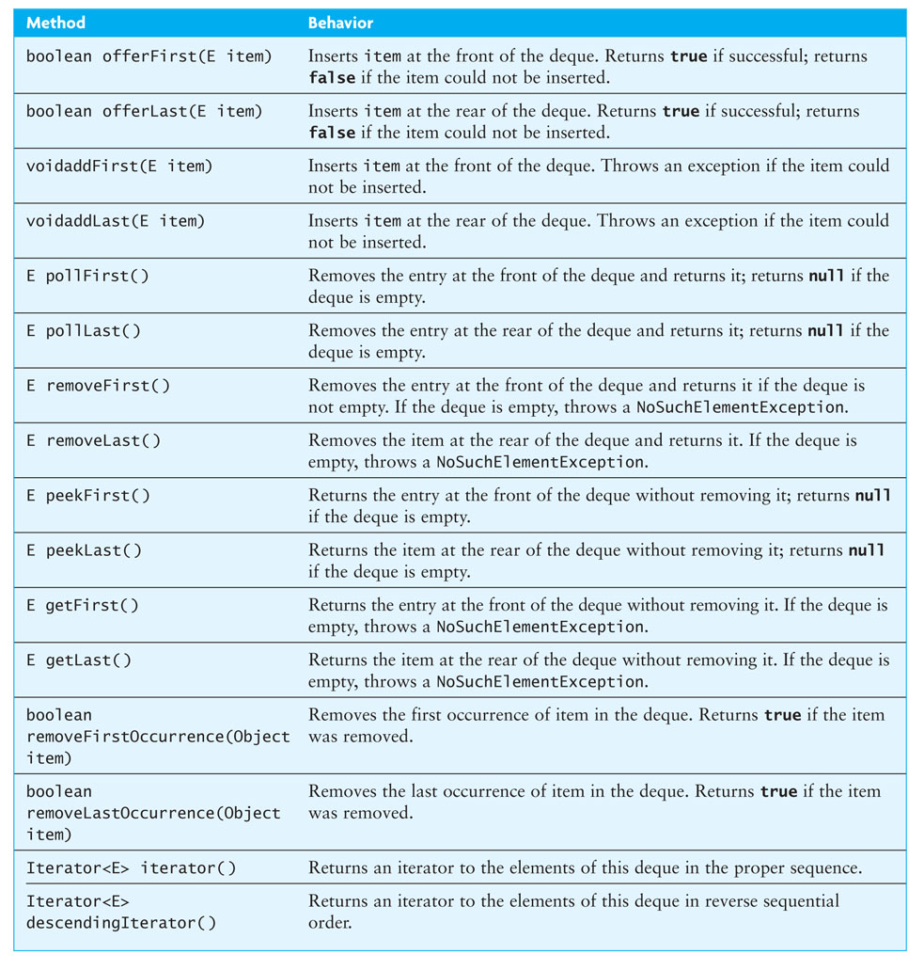
Deque Interface (cont.)

Slide 50
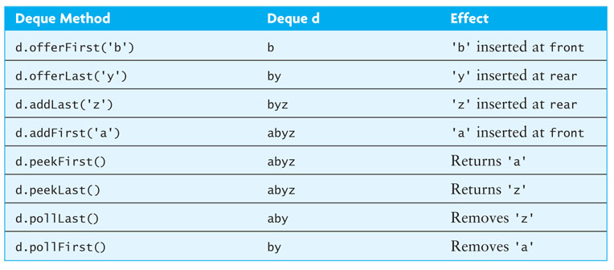
Deque Example

Slide 51
Deque Interface (cont.)
The Deque interface extends the Queue interface, so it can be used as a queue
A deque can be used as a stack if elements are pushed and popped from the front of the deque
Using the Deque interface is preferable to using the legacy Stack class (based on Vector)

Slide 52
Case Study
Blue Skies Airlines (BSA) would like to have two waiting lines:
regular customers
frequent flyers
Assuming only one ticket agent, BSA would like to determine the average wait time for taking passengers from the waiting lines using various strategies:
take turns serving passengers from both lines (one frequent flyer, one regular, one frequent flyer, etc.)
serve the passenger waiting the longest
serve any frequent flyers before serving regular passengers

Slide 53
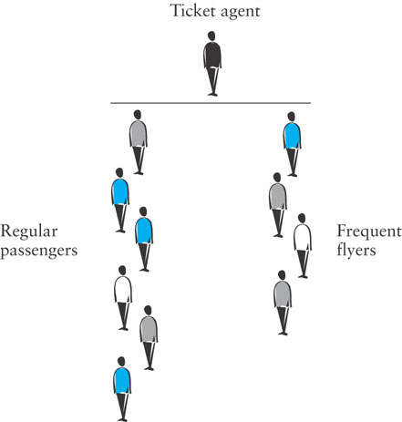
Case Study (cont.)

Slide 54
Visual Aids
Singly linked list implementation
https://visualgo.net/en/list
Array implementation
https://www.cs.usfca.edu/~galles/JavascriptVisual/QueueArray.html

